Slide 1
Introduction to Statistical Learning with R
March 22, 2018

Slide 2
Course Outline
What is Statistical Learning
Supervised and unsupervised learning
Regression analysis
Data classification
Support Vector Machine
Logistic Regression
Decision trees
Binary
Fuzzy logic
Neural networks
Cluster analysis
Reinforced learning
Informational Entropy

Slide 3
In Previous Training Sessions …
We already touched :
Exploratory Data Analysis
Regression
Clusters
These tools / methods belong to statistical learning

Slide 4
What is Statistical Learning
Statistical learning refers to a vast set of tools for understanding data
These tools can be classified as supervised or unsupervised
Supervised statistical learning involves building a statistical model for predicting, or estimating an output based on one or more inputs
The simplest supervised learning method is a linear regression model which can be used for estimating new input examples
With unsupervised statistical learning, there are inputs but no supervising output; we learn relationships and structure from such data
The most common unsupervised learning method is cluster analysis, which is used for exploratory data analysis to find hidden patterns or grouping in data

Slide 5
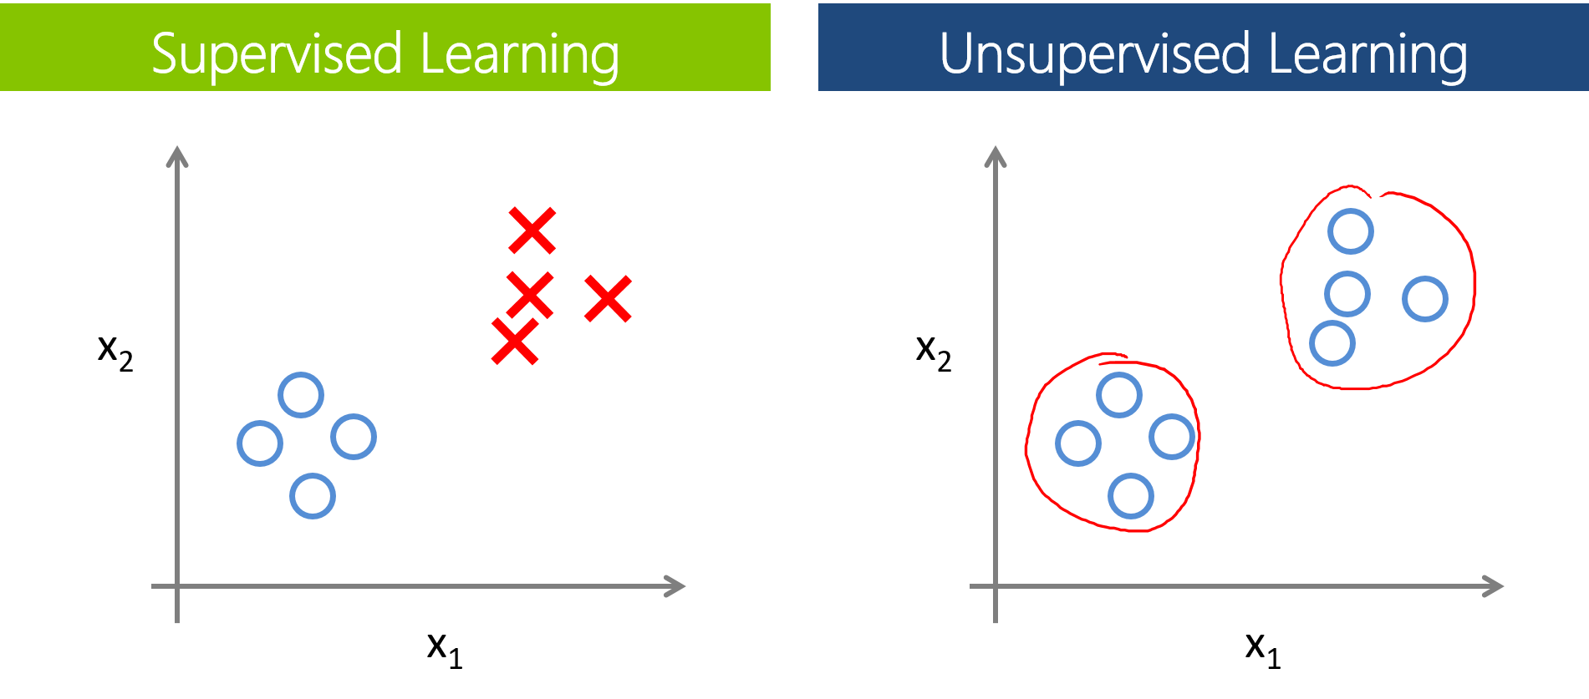
Supervised Vs. Unsupervised Learning
Training data is labelled
Categorize new data based on the training data
No training data
Find clusters and look for other dimensions to infer their nature

Slide 6
Why Do Statistical Learning
Prediction
Predict how the system works (black box approach)
Inference
Learn the relations among variables to
Understand causality
Optimize the system

Slide 7
History of Statistical Learning
Before 1970 – mostly linear methods (not enough computing power)
1795 – 1805: Least Squares by Gauss
1936: Linear Discriminant by Fisher for qualitative data
1940s: Logistic regression
1970s: Generalized linear model
(Non-normal error distribution)
1980s: first non-linear methods
2000s: practical machine learning and AI applications

Slide 8
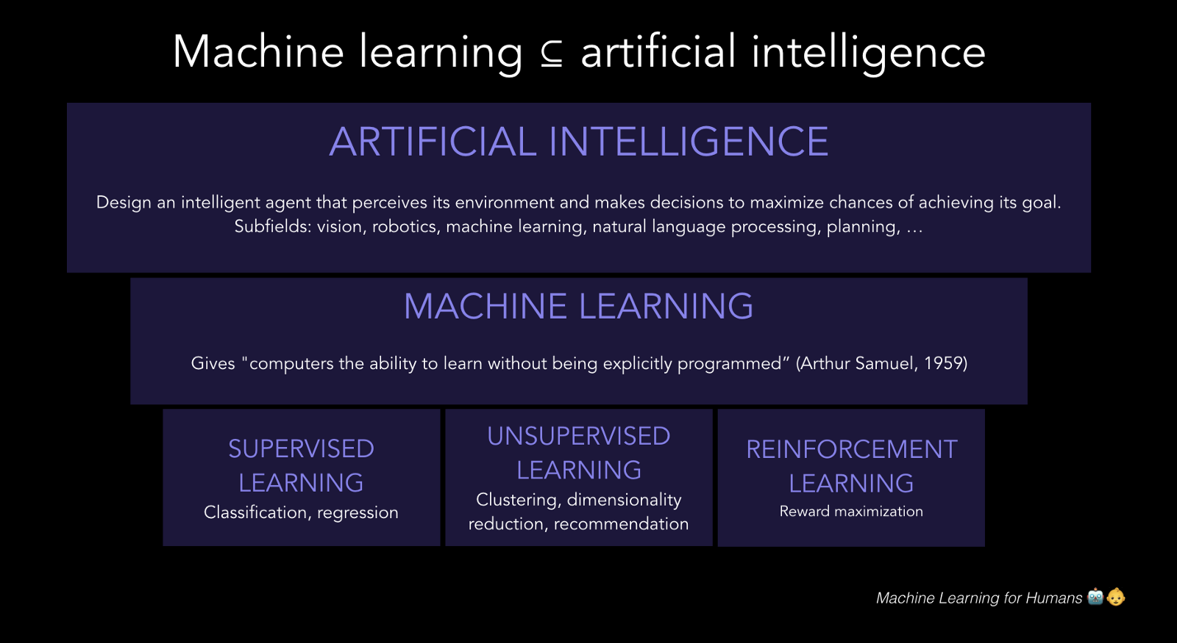
Statistical Learning, Machine Learning, and AI
Statistical Learning = Foundation for AI

Slide 9
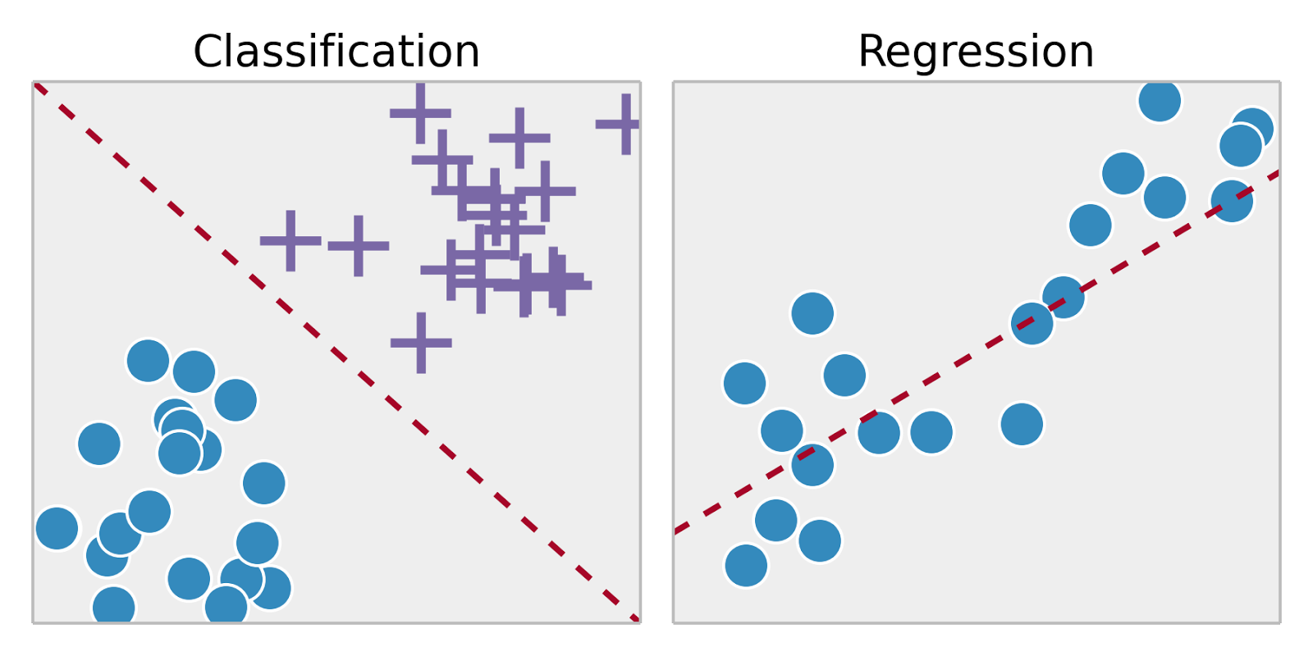
Supervised Learning
Analyze training data with known outcomes
Create – Train – Test the Model / Algorithm
Example
Predict income based on education
Y = f(X) + e (error)
For qualitative data => classification (label)
For quantitative data => regression (predict)

Slide 10
Regression Analysis Review of the example in Intro to Statistics Part 2

Slide 11
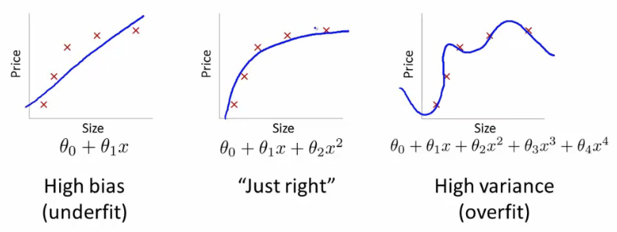
Underfit and Overfit Models
Underfit – not accurate enough
Overfit – not general enough
Eye test for overfit – too many inflexion points
Objective test for overfit – high variance

Slide 12
Smoothing Regression
Essentially smoothing is a filter (simplest is a low pass like running average)
Typically used when:
Fitting a line where noisy data values interfere with your ability to see a line of best fit
Linear regression where least squares fitting doesn’t create a line of good fit or is too labor-intensive to use
Data exploration and analysis in the social sciences, particularly in elections and voting behavior
Benefits of Non-Parametric Smoothing
Provides a flexible approach to representing data
Ease of use
Computations are relatively easy
Disadvantages of Non-Parametric Smoothing
Can’t be used to obtain a simple equation for a set of data

Slide 13
R Script for Scatter Plot, Linear Regression, and Smoothing
## linear regression
# iris data
View(iris)
head(iris, 5)
plot(iris)
plot(iris[1:4])
# linear regression (model)
fit1 = lm(Petal.Length~Petal.Width, data=iris)
summary(fit1)
plot(Petal.Length~Petal.Width, iris)
abline(fit1,col="red")
plot(fit1)
# iris subset setosa
Setosa = subset(iris, Species == "setosa")
plot(Setosa [1:4])
plot(density(Setosa$Petal.Length))
plot(density(Setosa$Sepal.Length))
# non-parametric local regression - filter
scatter.smooth(Petal.Length~Sepal.Length, data = Setosa)

Slide 14
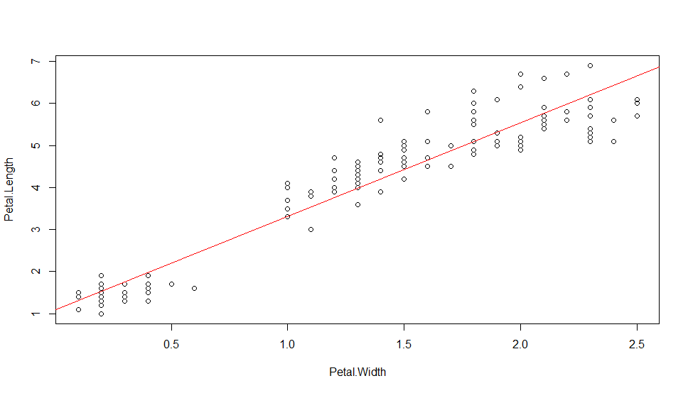
Understanding lm() Results
Target
Predictor
Petal.Length = 2.22994 * Petal.Width + 1.08356
summary(fit1)
Call:
lm(formula = Petal.Length ~ Petal.Width, data = iris)
Residuals:
Min 1Q Median 3Q Max
-1.33542 -0.30347 -0.02955 0.25776 1.39453
Coefficients:
Estimate Std. Error t value Pr(>|t|)
(Intercept) 1.08356 0.07297 14.85 <2e-16 ***
Petal.Width 2.22994 0.05140 43.39 <2e-16 ***
---
Signif. codes: 0 ‘***’ 0.001 ‘**’ 0.01 ‘*’ 0.05 ‘.’ 0.1 ‘ ’ 1
Residual standard error: 0.4782 on 148 degrees of freedom
Multiple R-squared: 0.9271,
Adjusted R-squared: 0.9266
F-statistic: 1882 on 1 and 148 DF, p-value: < 2.2e-16
https://feliperego.github.io/blog/2015/10/23/Interpreting-Model-Output-In-R

Slide 15
Non-Linear Regression
Analyst specifies a function with a set of parameters to fit to the data
The most basic way to estimate such parameters in R is to use a non-linear least squares function
nls(formula, data, start, ...)
formula is a nonlinear model formula including variables and parameters.
data is a data frame used to evaluate the variables in the formula.
start is a named list or named numeric vector of starting estimates

Slide 16
Non-Linear Regression Example
Data known to be difficult for linear regression
Michaelis–Menten formula
## non-linear least square regression
# simulate data
set.seed(20180309)
x<-seq(0,50,1)
y<-((runif(1,10,20)*x)/(runif(1,0,10)+x))+rnorm(51,0,1)
#for simple models nls find good starting values for the parameters even if it throw a warning
m<-nls(y~a*x/(b+x))
#get some estimation of goodness of fit
cor(y,predict(m))
plot(x,y)
lines(x,predict(m),lty=2,col="red",lwd=3)
z = lm(y~x)
abline(z, col = 'blue')

Slide 17
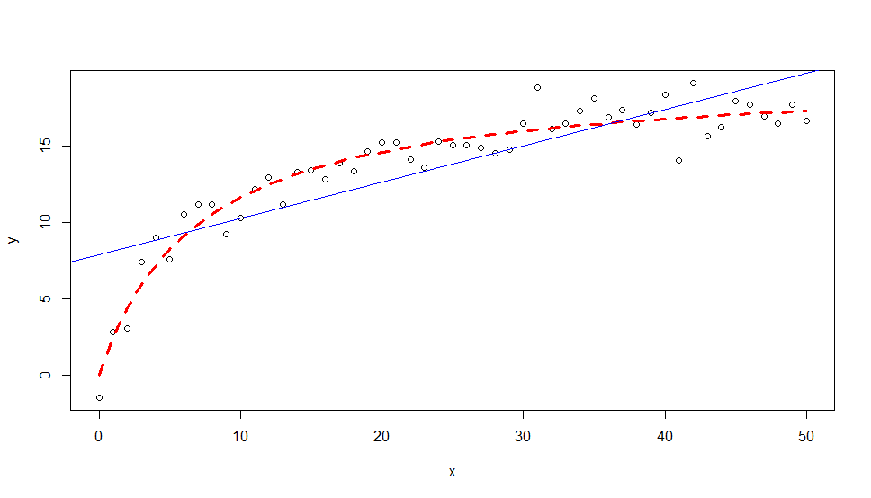
lm() and nls() for Michaelis–Menten Data
Non-linear regression
nlm()
Linear regression
lm()

Slide 18
Linear Regression with ggplot2
Analyst specifies a function with a set of parameters to fit to the data
The most basic way to estimate such parameters in R is to use a non-linear least squares approach (nls)
nls(formula, data, start, ...)
formula is a nonlinear model formula including variables and parameters.
data is a data frame used to evaluate the variables in the formula.
start is a named list or named numeric vector of starting estimates

Slide 19
R Script for Regression with ggplot2
library(ggplot2)
df = mtcars
# create multiple linear model
lm_fit <- lm(mpg ~ cyl + hp, data=df)
summary(lm_fit)
# save predictions of the model in the new data frame
# together with variable you want to plot against
predicted_df <- data.frame(mpg_pred = predict(lm_fit, df), hp=df$hp)
# predicted line of multiple linear regression
ggplot(data = df, aes(x = mpg, y = hp)) +
geom_point(color='blue') +
geom_line(color='red',data = predicted_df, aes(x=mpg_pred, y=hp))
# predicted line comparing only chosen variables
ggplot(data = df, aes(x = mpg, y = hp)) +
geom_point(color='blue') +
geom_smooth(method = "lm", col = 'red', se = FALSE)

Slide 20
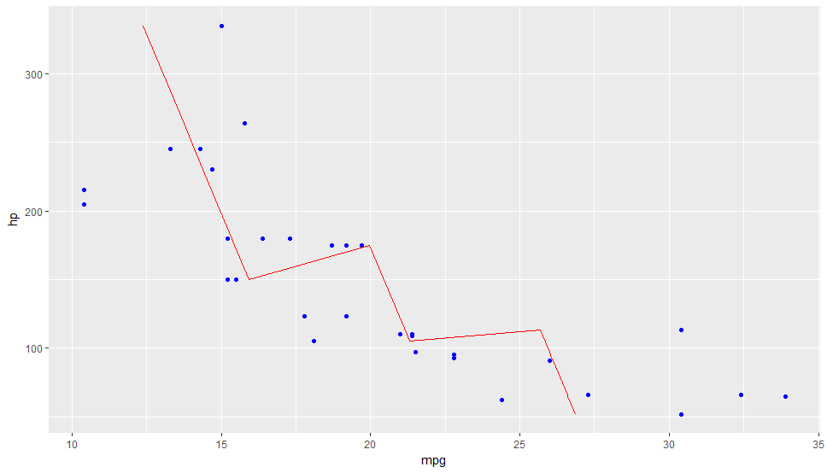
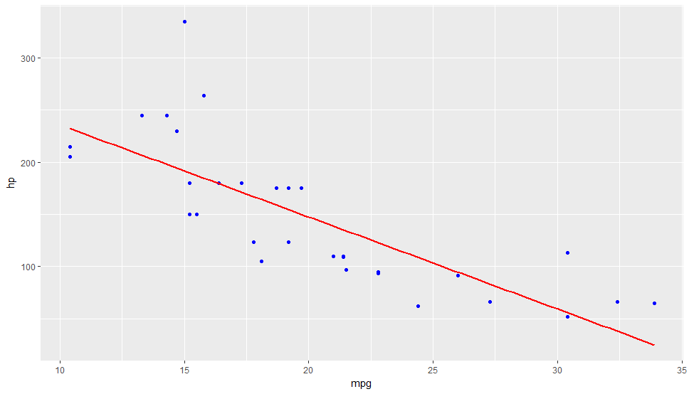
Multiple Linear Regression Vs. Linear Regression
Multiple Linear
Regression
Question:
Which one better shows the trend?
Linear
Regression

Slide 21
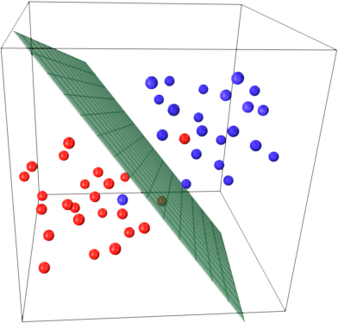
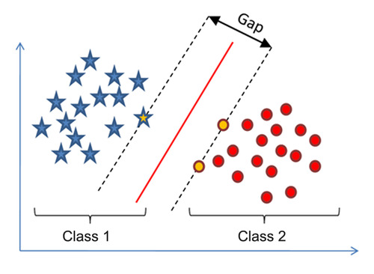
Classification with Support Vector Machine (SVM)
Find a line, curve, plane, surface that separates labelled training data
Apply to new data to label it

Slide 22
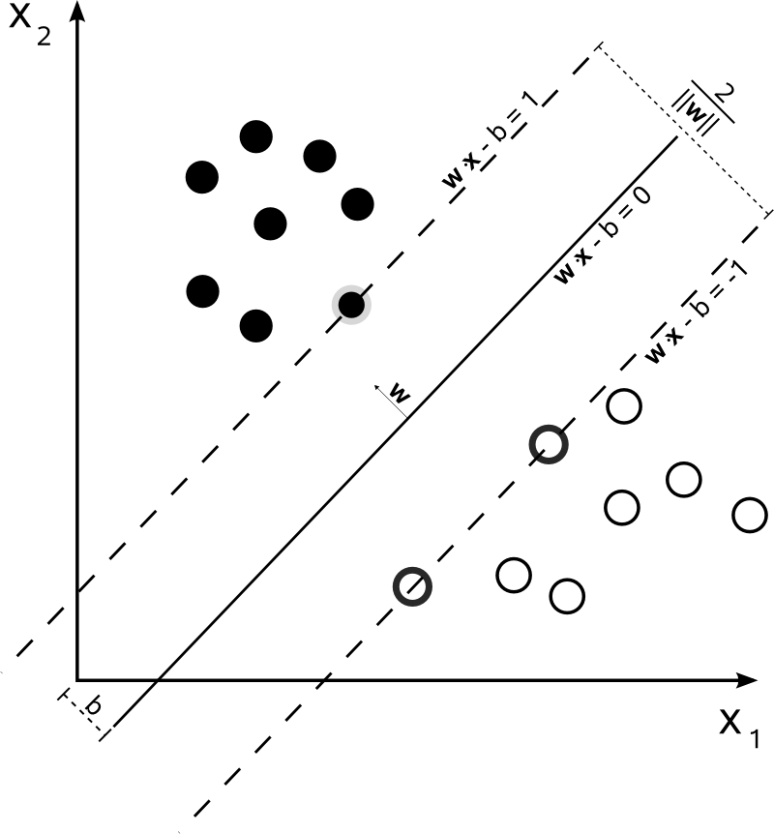
Quiz: What Is a Vector in SVM?
In R
A vector is a sequence of data elements of the same basic type.
In math:
A vector is an object that has both a magnitude and a direction: a directed line segment, whose length is the magnitude of the vector and with an arrow indicating the direction.
Question:
What kind of vector is in SVM?

Slide 23
R Script for SVM Example
## svm example with iris
library("e1071")
head(iris,5)
attach(iris)
x <- subset(iris, select=-Species)
y <- Species
svm_model <- svm(Species ~ ., data=iris)
summary(svm_model)
# you can do this alternatively
svm_model1 <- svm(x,y)
summary(svm_model1)
# run prediction (and measure execution time)
pred <- predict(svm_model1,x)
system.time(pred <- predict(svm_model1,x))
# see the confusion matrix
table(pred,y)
# tune svm parameters cost and gamma
svm_tune <- tune(svm, train.x=x, train.y=y,
kernel="radial", ranges=list(cost=10^(-1:2), gamma=c(.5,1,2)))
print(svm_tune)
# try tuned svm model
svm_model_after_tune <- svm(Species ~ ., data=iris, kernel="radial", cost=1, gamma=0.5)
summary(svm_model_after_tune)
# run prediction with the new model
pred <- predict(svm_model_after_tune,x)
system.time(predict(svm_model_after_tune,x))
# run confusion matrix for the new model
table(pred,y)
# continue perfecting...

Slide 24
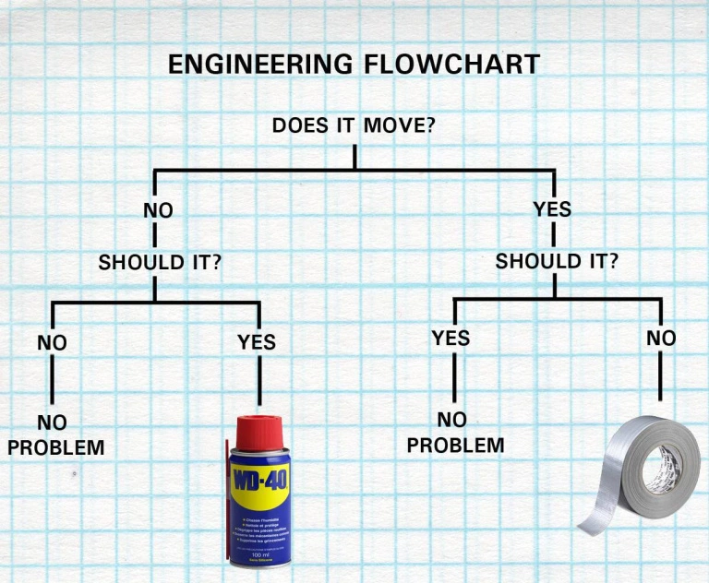
Logistic Regression with Binary Decision Tree

Slide 25
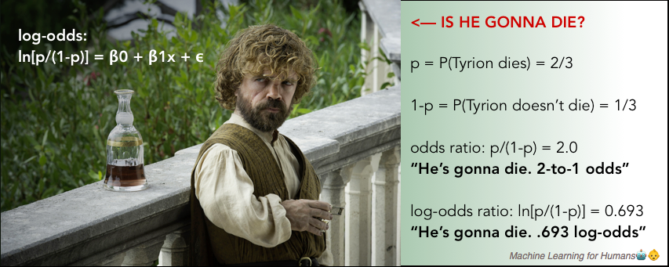
Logistic Regression
Regression model for categorical variable
Example: binary classification, e.g. Yes/No
Compare probabilities for Yes and No – odds ratio
Use log-odds function (or sigmoid to place the value between “0” and “1”)
Compare result to a threshold

Slide 26
Quiz: Do You Remember Probability
Patient:
Doctor, I just learned that the surgery you are recommending has 10% survival rate!
Doctor:
Do not worry, Sir! The ninth patient I have operated on has just died.
Question 1:
Is it safe now to do the surgery?
Question 2:
How coin toss is different from taking out (and not putting back) dark and milk chocolate cookie from a jar?
Ten times coin toss – does probability of head go up if you have nine tails in a row?
Nine dark cookies and a milk one in a jar – what is a probability of getting the milk cookie after you pulled out and ate nine dark ones?

Slide 27
Other Types of Decision Engines
What if you cannot cleanly split your data with a yes/no question?
What if the answer is maybe?
For these cases we need human-like reasoning
Fuzzy logic
Neutral networks
Both turn “maybe” into a probability of Yes or No (“level of truth”)
Yes
1
“Maybe”
No
0

Slide 28
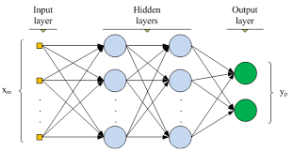
Fuzzy Logic Vs. Neural Network
Both allow to “weigh” your “maybe” based on how much it leans toward yes (or no)If
e.g.: IF a > b AND b > c, THEN d
Input a
Rules
Fuzzy logic has an inference engine controlled by a set of rules
Convert to Probability
Inference Engine
Select an Output
Input b
Neural network logic is distributed over hidden layer(s) nodes/perceptrons
Emulates the human neurons

Slide 29
Neural Network Example
Algorithm which can guess if a college is private or public based on admission and graduation data
Dataset College from ISLR package
All numeric-value columns
Except for one categorical column: Private Yes/No
Steps
Pre-process the data:
Normalize
Convert Yes/No to 1/0
Split the data into two sets:
Training
Test
Apply neural network package “neuralnet”
Train the algorithm
Assess results (confusion matrix)

Slide 30
R Script for Data Classification Example with Neural Network
## create neural network example
library(ISLR)
print(head(College,2))
# Create Vector of Column Max and Min Values
maxs <- apply(College[,2:18], 2, max)
mins <- apply(College[,2:18], 2, min)
# Use scale() and convert the resulting matrix to a data frame
scaled.data <- as.data.frame(scale(College[,2:18],center = mins, scale = maxs - mins))
# Check out results
print(head(scaled.data,2))
# split the data into training and test datasets
# Convert Private column from Yes/No to 1/0
Private = as.numeric(College$Private)-1
data = cbind(Private,scaled.data)
library(caTools)
set.seed(101)
# Create Split (any column is fine)
split = sample.split(data$Private, SplitRatio = 0.70)
# Split based off of split Boolean Vector
train = subset(data, split == TRUE)
test = subset(data, split == FALSE)
# create a formula to insert into the machine learning model
# simple script to create the expanded formula and save us some typing
feats <- names(scaled.data)
# Concatenate strings
f <- paste(feats,collapse=' + ')
f <- paste('Private ~',f)
# Convert to formula
f <- as.formula(f)
f
# install package neuralnet
library(neuralnet)
nn <- neuralnet(f,train,hidden=c(10,10,10),linear.output=FALSE)
# Compute Predictions off Test Set
predicted.nn.values <- compute(nn,test[2:18])
# Check out net.result
print(head(predicted.nn.values$net.result))
predicted.nn.values$net.result <- sapply(predicted.nn.values$net.result,round,digits=0)
table(test$Private,predicted.nn.values$net.result)
plot(nn)

Slide 31
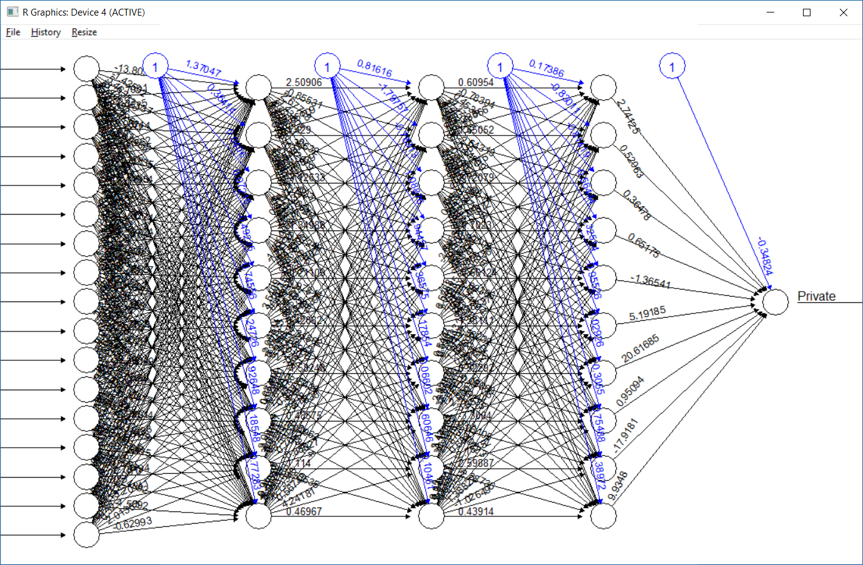
Neural Network to Categorize College as Private or Public

Slide 32
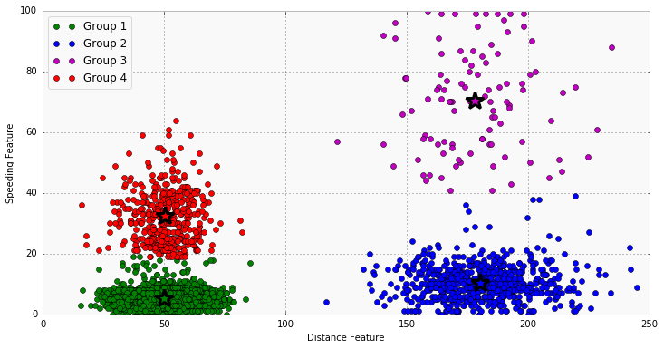
Cluster Analysis
Grouping of similar objects in multivariate data set
Example: grouping by distance from center
Variable 1
Variable 2

Slide 33
R Script for k-means (Review “From Intermediate R Training Part 2”)
library(ggplot2)
ggplot(iris, aes(Petal.Length, Petal.Width, color = Species)) + geom_point()
set.seed(20)
irisCluster <- kmeans(iris[, 3:4], 3, nstart = 20)
irisCluster
table(irisCluster$cluster, iris$Species)
irisCluster$cluster <- as.factor(irisCluster$cluster)
ggplot(iris, aes(Petal.Length, Petal.Width, color = irisCluster$cluster)) + geom_point()
Or:
ggplot(iris, aes(y = Petal.Length, x = seq(1, length(iris$Sepal.Length)), color = irisCluster$cluster)) + geom_point()
irisCluster1 = kmeans(iris[,3], 3, nstart = 20)
irisCluster1
table(irisCluster1$cluster, iris$Species)

Slide 34
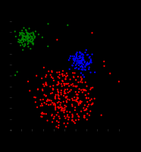
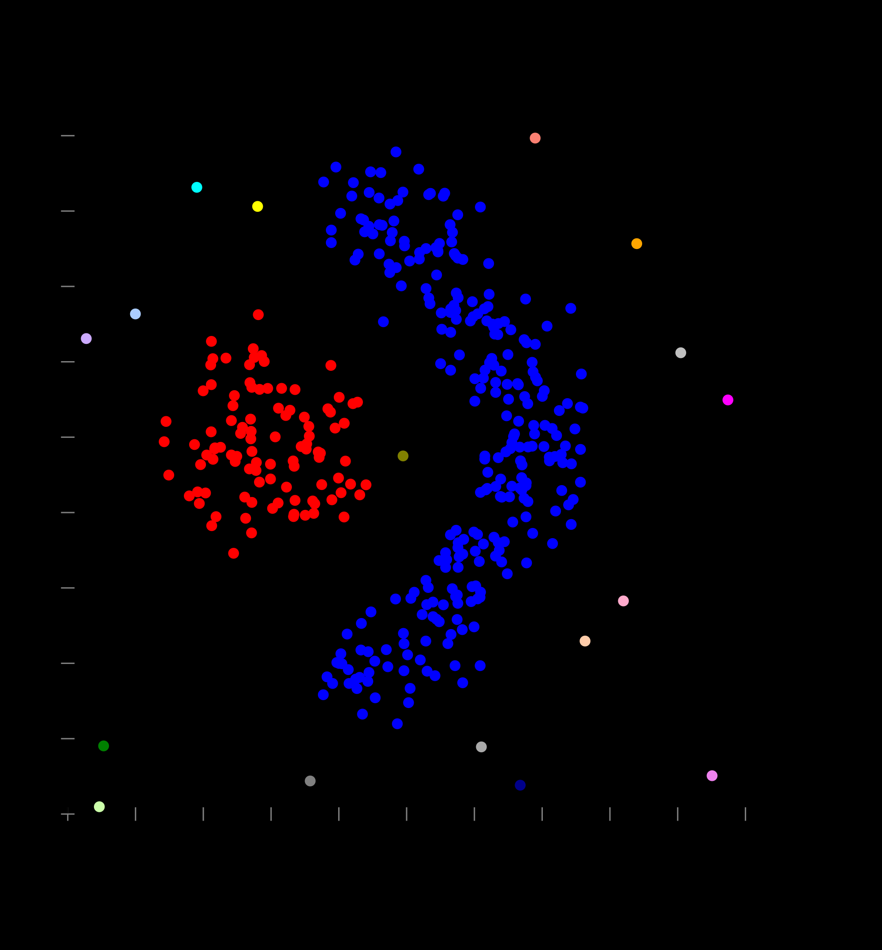
Distance-based Clusters
Centroid Clusters
(distance to center)
Curved Line Clusters
(distance to line)

Slide 35
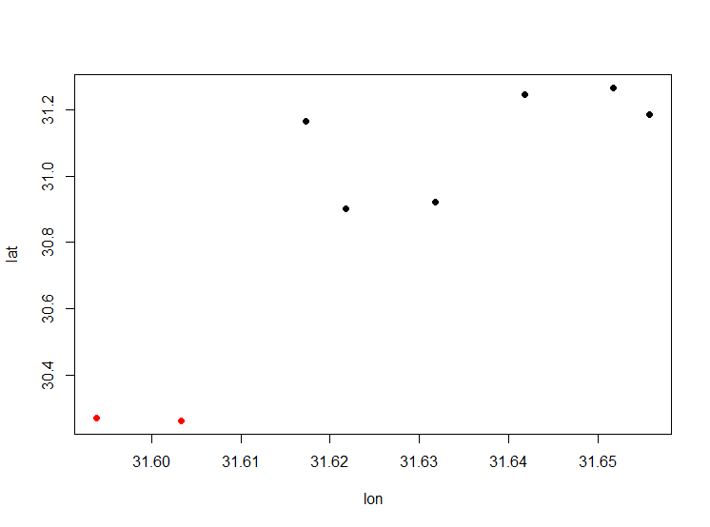
Spatial Clustering Example w/ fields Package
library(fields)
lon = c(31.621785, 31.631785, 31.641773, 31.651785,31.617269, 31.655785, 31.593895, 31.603284)
lat = c(30.901118, 30.921118, 31.245008, 31.265008, 31.163886, 31.183886, 30.27058, 30.262378)
threshold.in.km <- 40
coors <- data.frame(lon,lat)
#distance matrix
dist.in.km.matrix <- rdist.earth(coors,miles = F,R=6371)
#clustering
fit <- hclust(as.dist(dist.in.km.matrix), method = "single")
clusters <- cutree(fit,h = threshold.in.km)
plot(lon, lat, col = clusters, pch = 19)

Slide 36
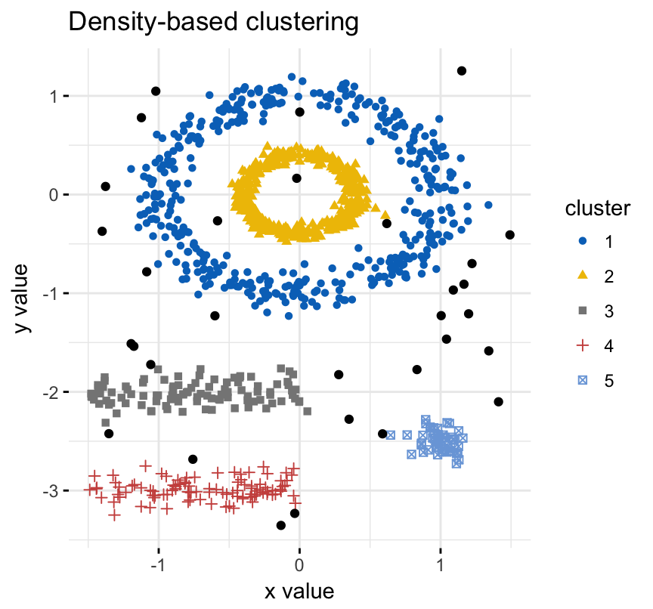
Density-based Clusters
Distance to adjacent data points
# rscript
install.packages("fpc")
install.packages("dbscan")
install.packages("factoextra")
install.packages("modeltools")
# Load the data
data("multishapes", package = "factoextra")
df <- multishapes[, 1:2]
# Compute DBSCAN using fpc package
library("fpc")
set.seed(123)
db <- fpc::dbscan(df, eps = 0.15, MinPts = 5)
# Plot DBSCAN results
library("factoextra")
fviz_cluster(db, data = df, stand = FALSE,
ellipse = FALSE, show.clust.cent = FALSE,
geom = "point",palette = "jco", ggtheme = theme_classic())

Slide 37
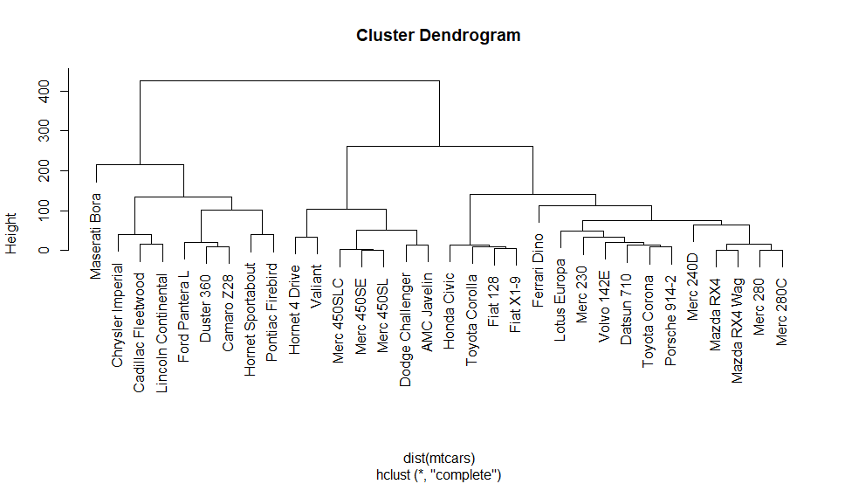
Hierarchical Clustering: Dendrogram
Dendrogram is a visual representation of compound-correlation data
The vertical axis Height refers to a distance measure between compounds or compound clusters
The height of the node can be thought of as the distance value between the right and left sub-branch clusters
## r script
# prepare hierarchical cluster
hc = hclust(dist(mtcars))
# very simple dendrogram
plot(hc)
https://rpubs.com/gaston/dendrograms
http://www.nonlinear.com/support/progenesis/comet/faq/v2.0/dendrogram.aspx

Slide 38
Clustering Tendency
Clustering algorithms, including partitioning methods (K-means, PAM, CLARA and FANNY) and hierarchical clustering, are used to split the dataset into groups or clusters of similar objects
Before applying any clustering method on the dataset, a natural question is:
Does the dataset contain any inherent clusters?
A big issue is that clustering methods will return clusters even if the data does not contain any clusters
if you blindly apply a clustering analysis on a dataset, it will divide the data into clusters because that is what it supposed to do
Therefore, before choosing a clustering approach, an analyst has to decide whether the dataset contains meaningful clusters (i.e. nonrandom structures) or not, and, if yes, then how many clusters are there
This process is defined as the assessing of clustering tendency or the feasibility of the clustering analysis
http://www.sthda.com/english/wiki/print.php?id=238

Slide 39
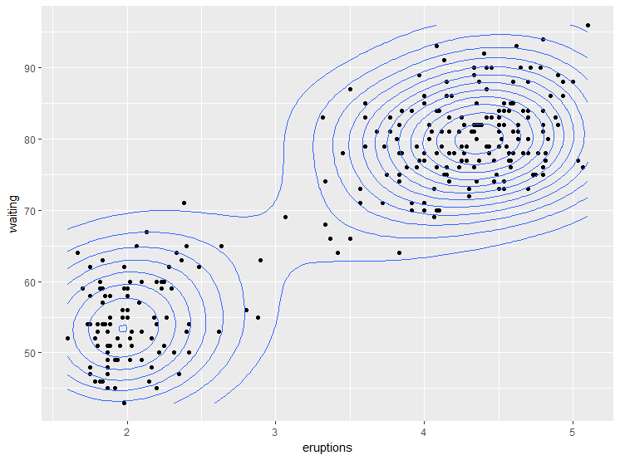
Clustering Tendency with ggplot2
geom_density parameter – a smoothed version of histogram
Creates density isolines
Example uses “faithful” dataset in R built in
## r script
## Clustering tendency with ggplot
data("faithful")
df <- faithful
library("ggplot2")
ggplot(df, aes(x=eruptions, y=waiting)) +
geom_point() + # Scatter plot
geom_density_2d() # Add 2d density estimation

Slide 40
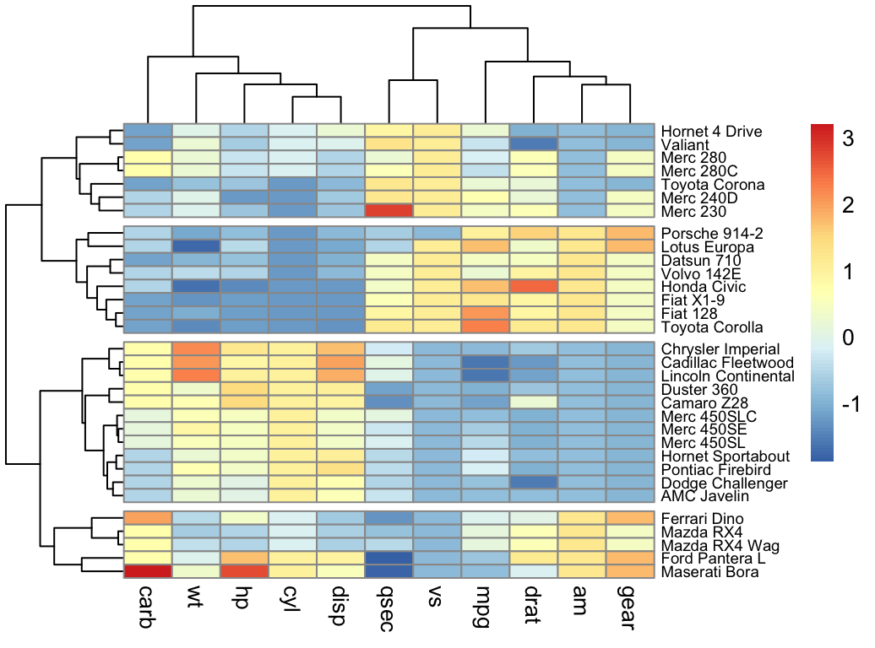
Clustering Tendency with Heatmap and Dendrogram

Slide 41
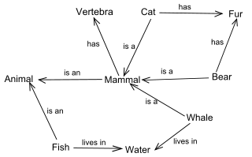
Word Clusters by Semantic Similarity, Relatedness, and Distance
Similarity (likeness, synonymy)
Bank – trust
Relatedness
Car – wheel
Pencil – paper
Distance: inverse of Similarity or Relatedness
Distance can be computed using topology tree
Once we have semantic distances, we can create semantic clusters
R packages NLTK, wordnet

Slide 42
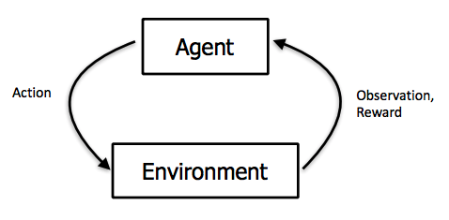
Reinforced Learning
Extension of supervised learning
Based on Markov Decision Process
An outcome value for an action (input value) is not explicitly provided (therefore, an error is not computed)
Instead, the system (“environment”) “rewards” “agent’s” actions towards a desirable outcome and “punishes” actions taking an away from a goal

Slide 43
Information Content of a Variable
Regression allow to explore relationships among variable
What about info contained in a variable?
We can assess a variable
Histogram
Factor variable (e.g. list all values a variable can take)
https://stats.idre.ucla.edu/r/modules/factor-variables/
Question: is there a way to measure amount of information in a variable?

Slide 44
Amount of Information
We can count number of bytes, but this would be rather size than amount of information
Informational Entropy offers a way to measure the amount of info contained in a variable
Entropy depends on probability of a variable to take certain value
For a discrete variable, entropy is a function of frequency with which the variable is taking certain values
The more values the variable can take, the high is the entropy of the variable

Slide 45

Informational Entropy
Came into statistics from information science
Is a measure of unpredictability (uncertainty) of a variable
P(x_{i}) – probability of a value of a discrete variable
E.g.: (Frequency of value)/(Number of values)
Entropy has a range from 0 to 1
If the data is completely homogeneous (all samples are same), the entropy is zero
If the data is totally random, the entropy is 1

Slide 46
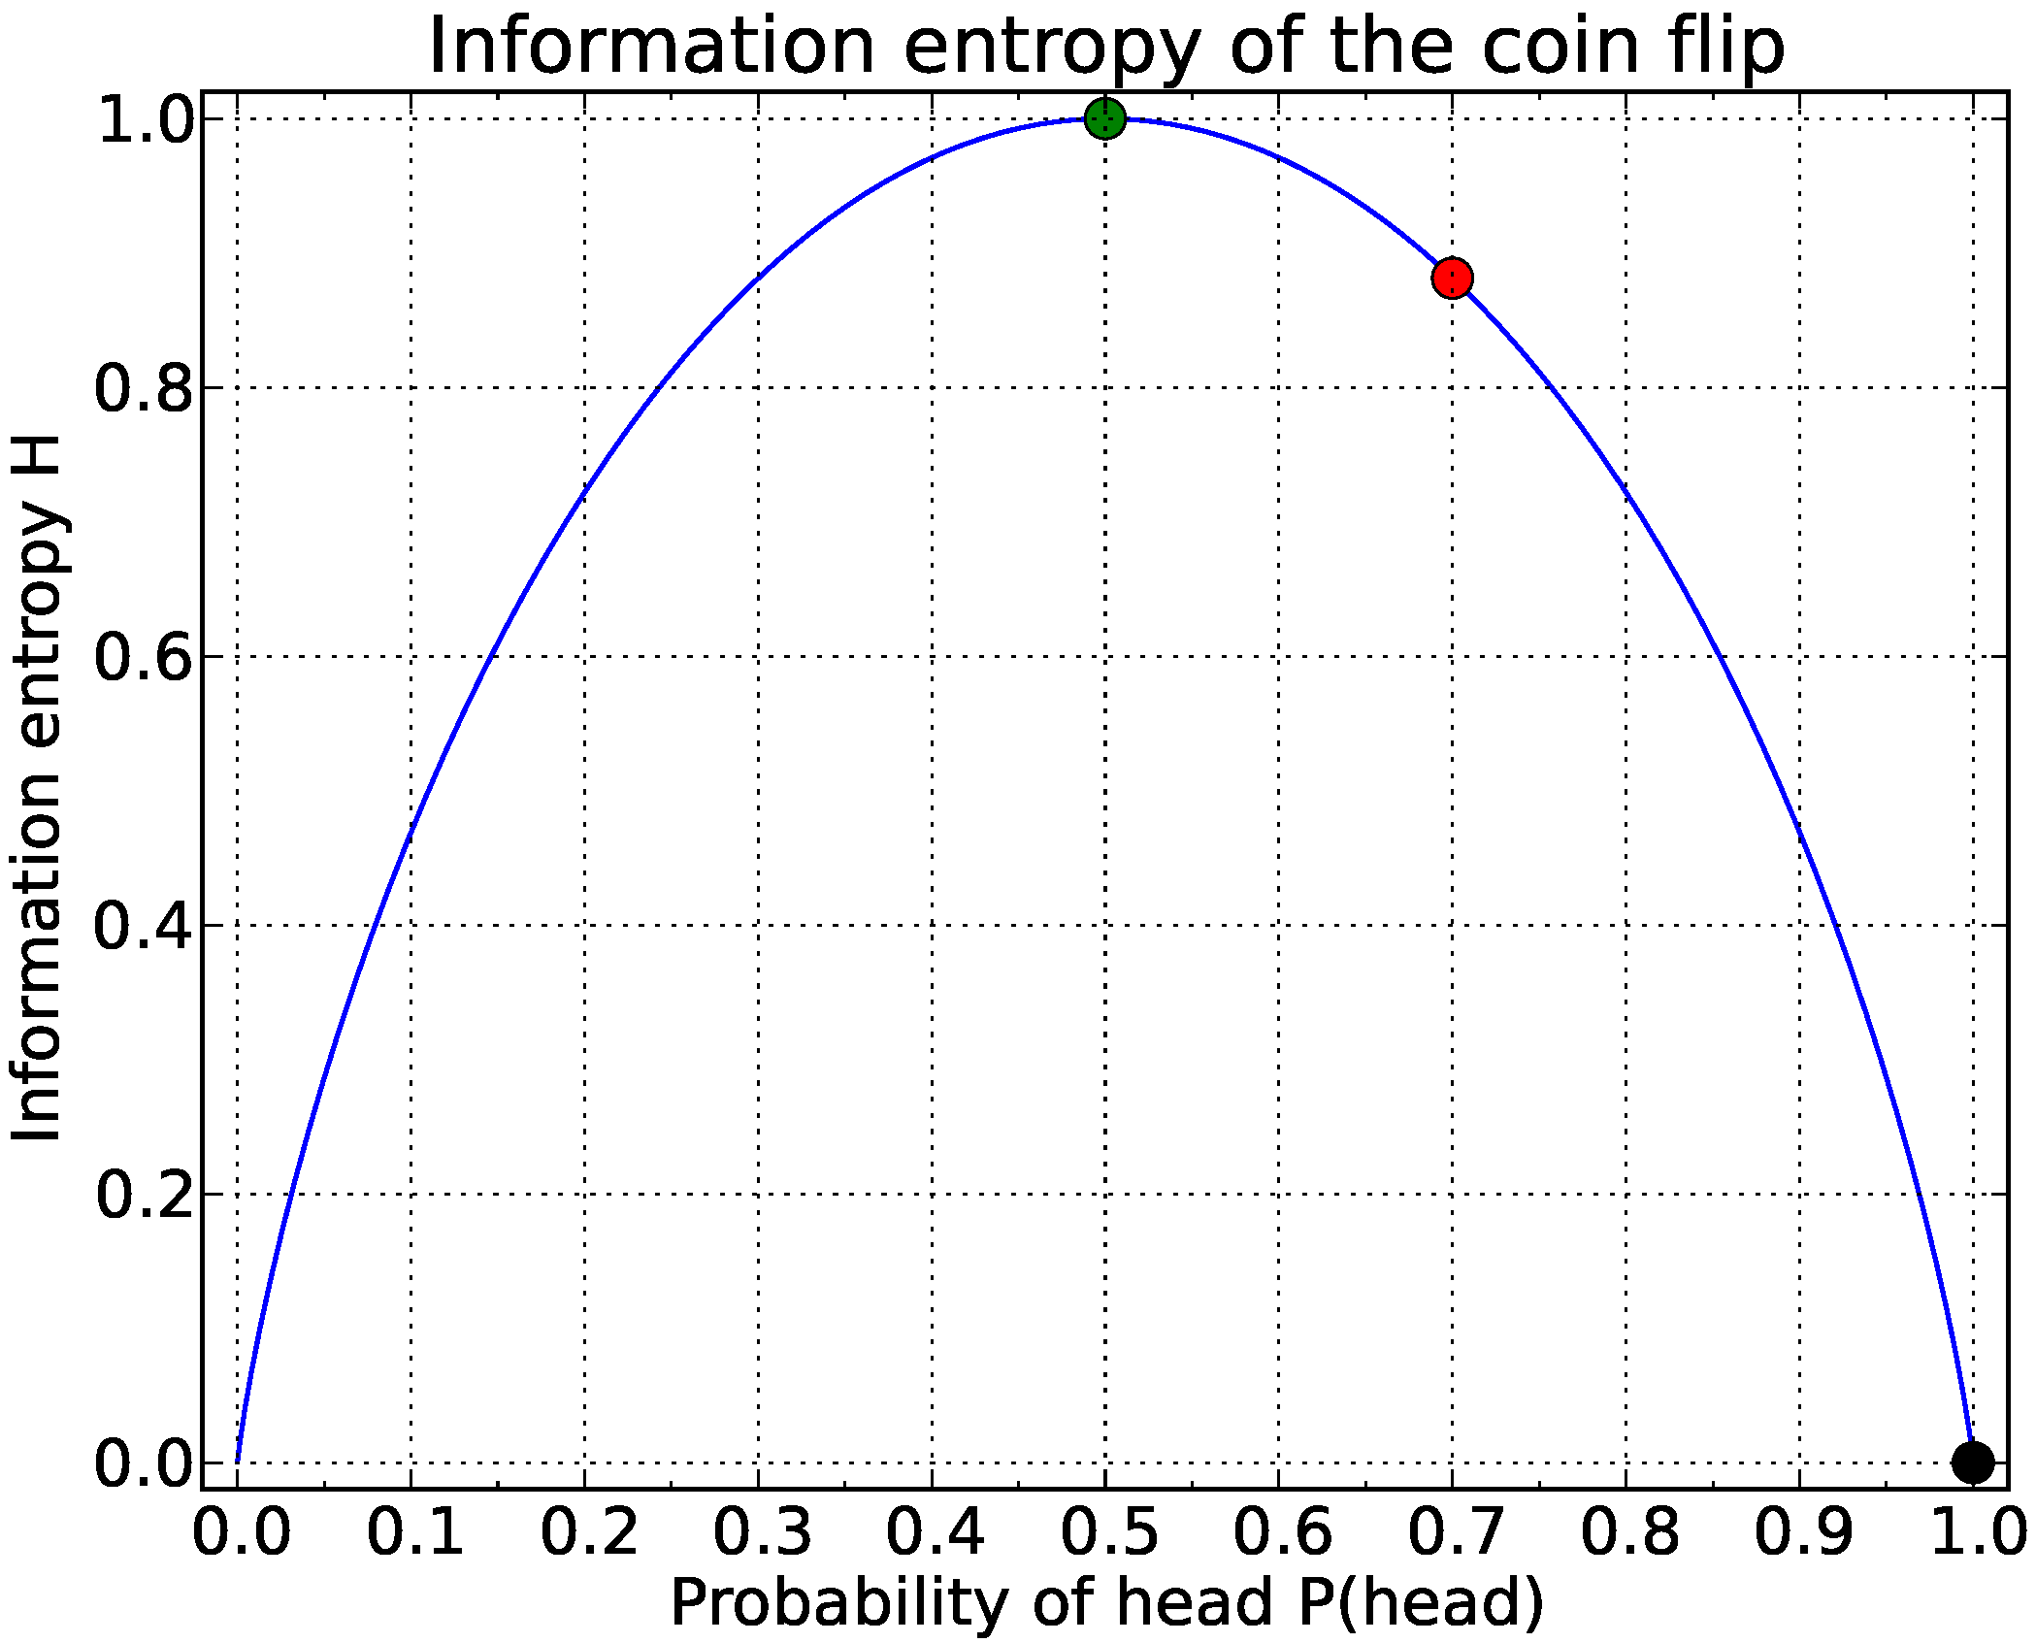
Entropy of a Coin Toss (Binary Function)
Unfair Coin
Fair Coin
Claude Shannon definition of entropy:
H(X) = - Q(Y) log₂ Q(X) - P(X) log₂ P(X)
Think of a coin toss as a variable with two outcomes: heads Q(X) or tails P(X)
Log₂ – defines entropy units - bits (can also be in Ln - nats and Lg -bans)
Probability 0 or 1: Entropy = 0, homogeneous data (“data purity”)
Probability 0.5: Entropy = 1, equally divided data

Slide 47
Why Shannon Used Logarithmic Function in Entropy?
Why is log() often used in theory of probability?
Short answer: because it works
Why does log work well with probabilities?
Conditional probability (probability of A if B already happen)
P(A|B) = P(A) * P(B)
P(A|B|C) = P(A) * P(B) * P(C)
(Computing permutations also require multiplication)
Basic property of logarithms
Log(P(A) * P(B)) = Log(P(A)) + Log(P(B))
Addition is much easier to work with than multiplication

Slide 48
Information Gain
The information gain is based on the decrease in entropy after a dataset is split on an attribute
Information Gain = Entropy(parent) – Entropy(children)
Find an attribute that returns the highest information gain for an attribute you are interested in
Split on attribute A, so you get max gain on attribute B

Slide 49
Entropy Consideration for Binary Decision Tree
Split on attribute “Does it move?”
Analyze gain on attribute “Should it move?”

Slide 50
Information Gain Example Using Frequencies of Attribute Values
Object Name | Does it Move (DIM) | Should it Move (SIM)
A | Y | N
B | Y | Y
C | Y | Y
D | N | Y
E | N | Y
F | N | Y
G | N | N
1 out of 3
Subset ABC
DIM?=Y
3 out of 7
2 out of 3
Subset DEFG
DIM?=N
4 out of 7
3 out of 4
1 out of 4
Entropy of the full set ABCDEF on DIM attribute =
- (3/7)log₂(3/7) - (4/7)log₂(4/7) = 0.5 + 0.5 = 0.99
Entropy of the child set ABC =
= - (2/3)log₂(2/3) - (1/3)log₂(1/3) = 0.39 + 0.53 = 0.92
Entropy of the child set DEFG =
= - (3/4)log₂(3/4) - (1/4)log₂(1/4) = 0.31 + 0.5 = 0.81
Information gain =
= Entropy(ABCDEF) – (3/7) * Entropy(ABC) – (4/7) * Entropy(DEFG) = 0.25

Slide 51
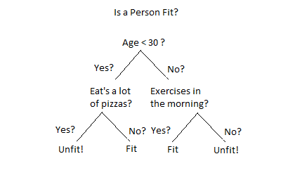
Decision Tree Information Gain ID3 Algorithm (Iterative Dichotomiser 3)
Data mining algorithm invented by J.Ross Quinlan in 1975
Compute entropy of the total data set
Split the dataset on different attributes
Compute entropy for each branch
Define the attribute giving the biggest information gain (decrease of entropy)
Use this attribute for decision node

Slide 52
Orthogonality in Statistics
Term comes from vector math: orthogonal means lies in perpendicular plane
Projection of A on B is 0
Made into statistics through linear algebra
For matrices: [X]^{T} * [X] = I
For vectors: A.B = 0
Meaning for statistical variables in data frame: uncorrelated - not truly orhtogonal
Advantages of datasets with truly independent (“orthogonal”) variables
Easy to analyze
Better support for decision trees
Can be converted into matrix and allow vector math (linear algebra)
A
B

Slide 53
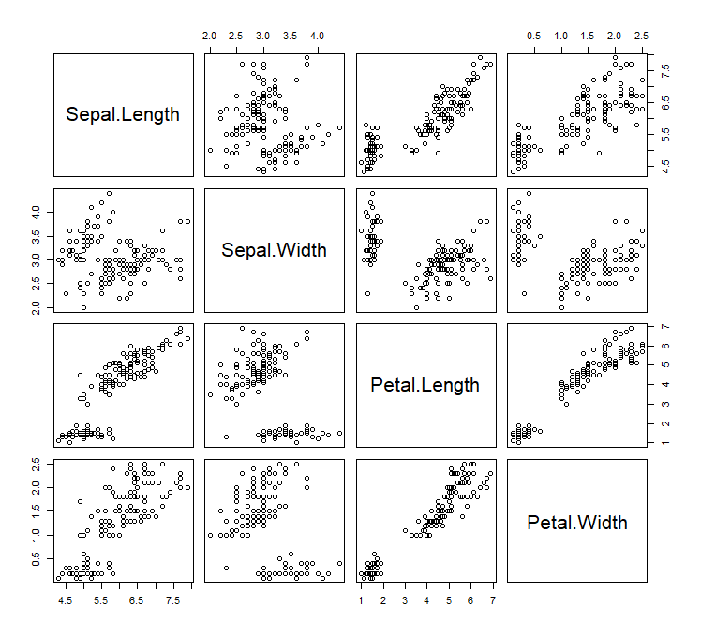
Quiz: Orthogonality of Dimensions
In math dimensions are orthogonal: length, width, height
Analytical tools use “generalized” definition of dimension, dimension is an attribute, a column name in a table
Show pairs of truly orthogonal dimensions on the graph
What math functions can be performed on these pairs?
Setosa = subset(iris, Species == "setosa")
plot(Setosa [1:4])

Slide 54
References
General
http://www-bcf.usc.edu/~gareth/ISL/ISLR%20First%20Printing.pdf
https://www.r-bloggers.com/in-depth-introduction-to-machine-learning-in-15-hours-of-expert-videos/
https://web.stanford.edu/~hastie/Papers/ESLII.pdf
https://medium.com/machine-learning-for-humans/why-machine-learning-matters-6164faf1df12
Linear Regression
http://r-statistics.co/Linear-Regression.html
SVM
http://math.stanford.edu/~yuany/course/2015.fall/SVM_in_R.pdf
https://rischanlab.github.io/SVM.html
Neural networks
https://www.kdnuggets.com/2016/08/begineers-guide-neural-networks-r.html
Entropy
https://stackoverflow.com/questions/1859554/what-is-entropy-and-information-gain
https://www.miniwebtool.com/log-base-2-calculator/
Cluster Analysis
http://www.sthda.com/english/articles/30-advanced-clustering/105-dbscan-density-based-clustering-essentials/

Slide 55
Q & A

